Slide 1


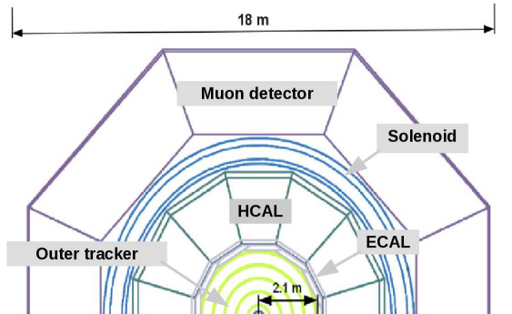
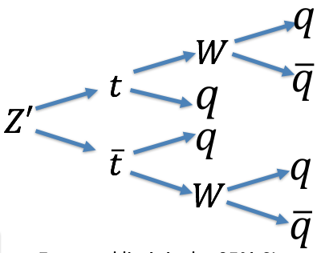
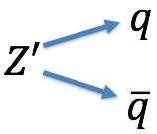
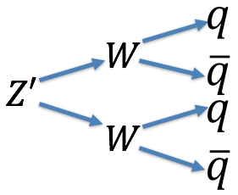
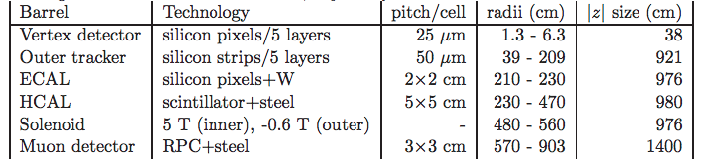
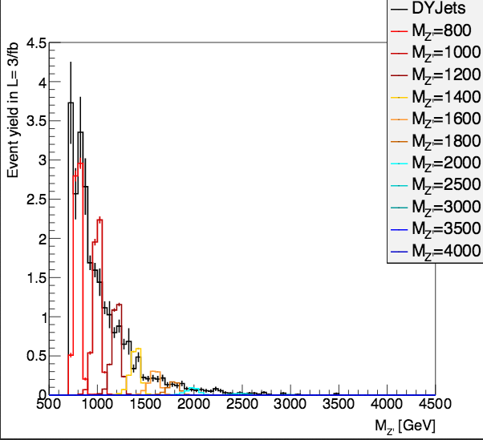
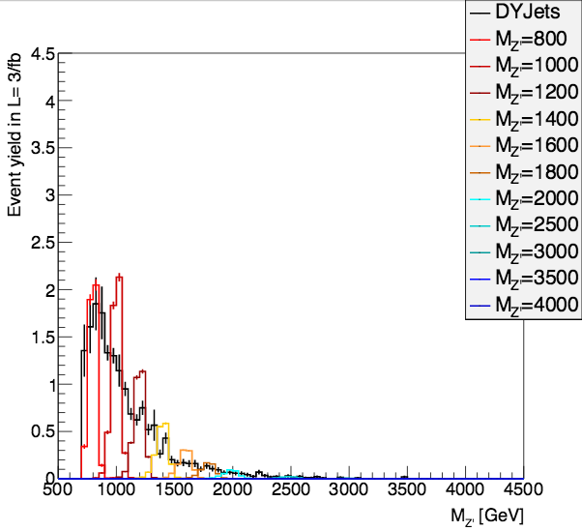
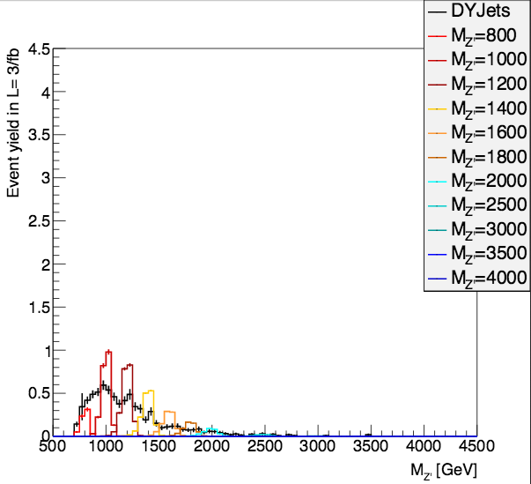
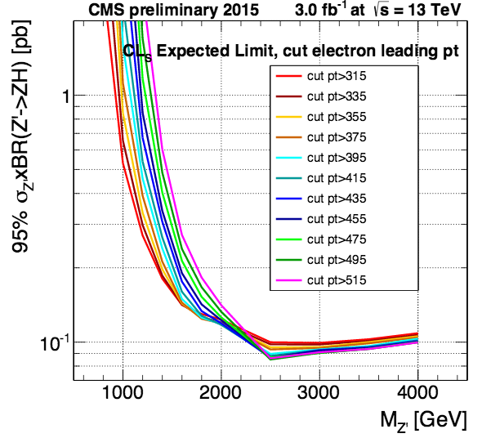
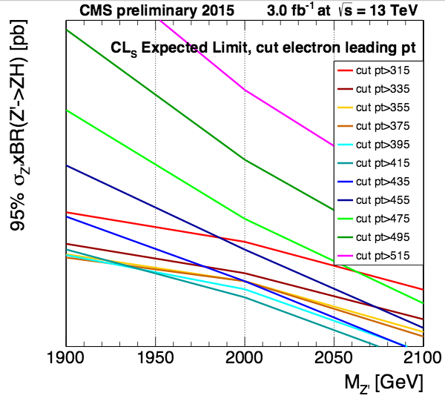
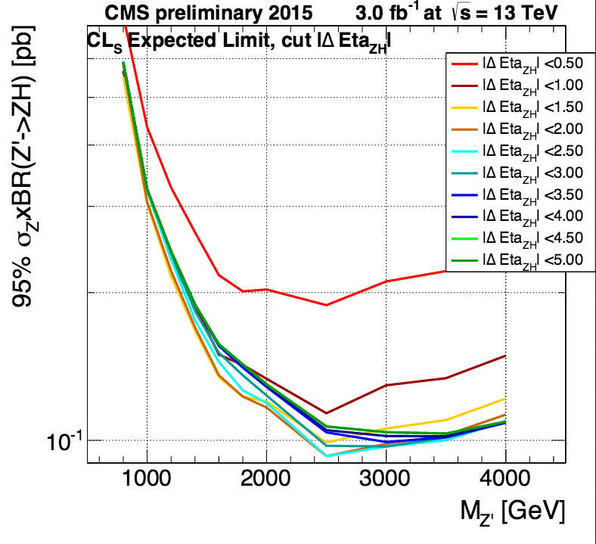
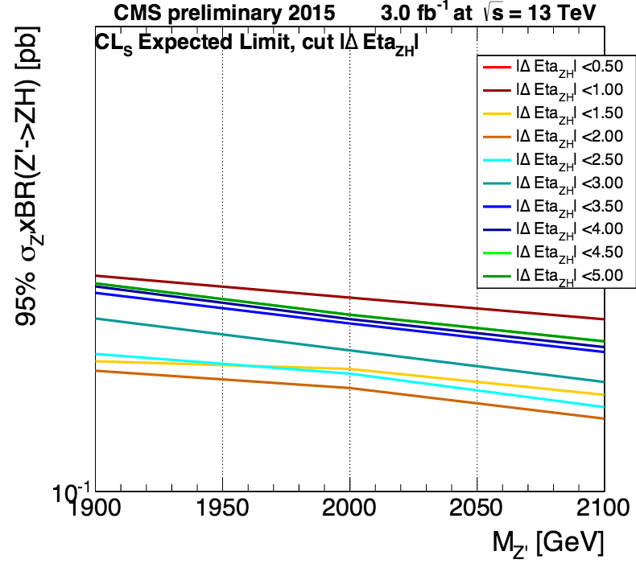
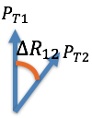
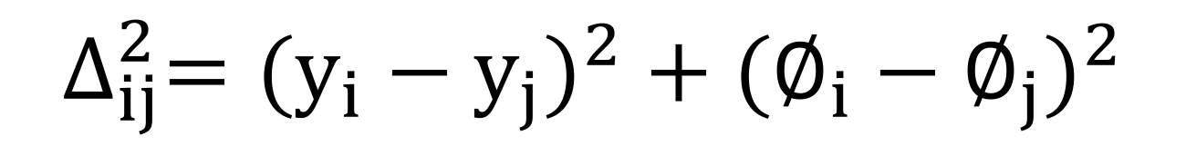
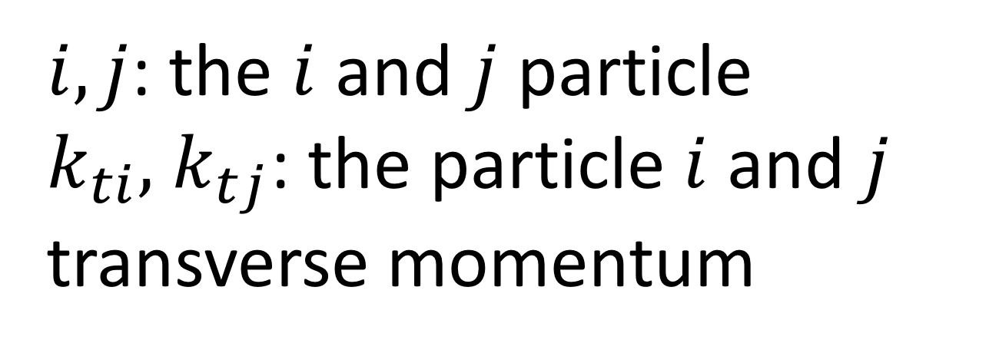



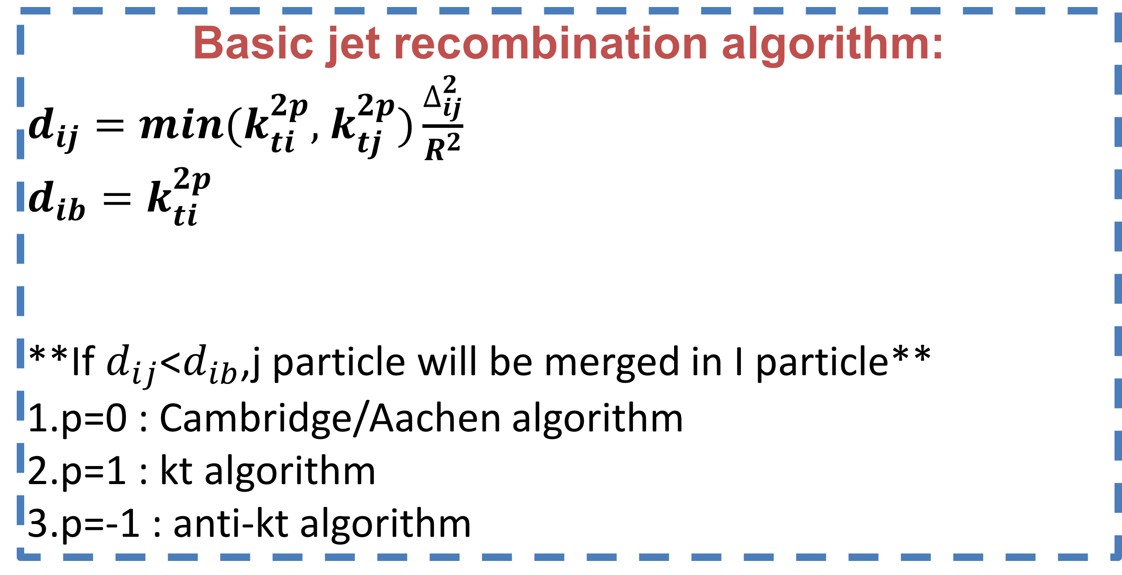

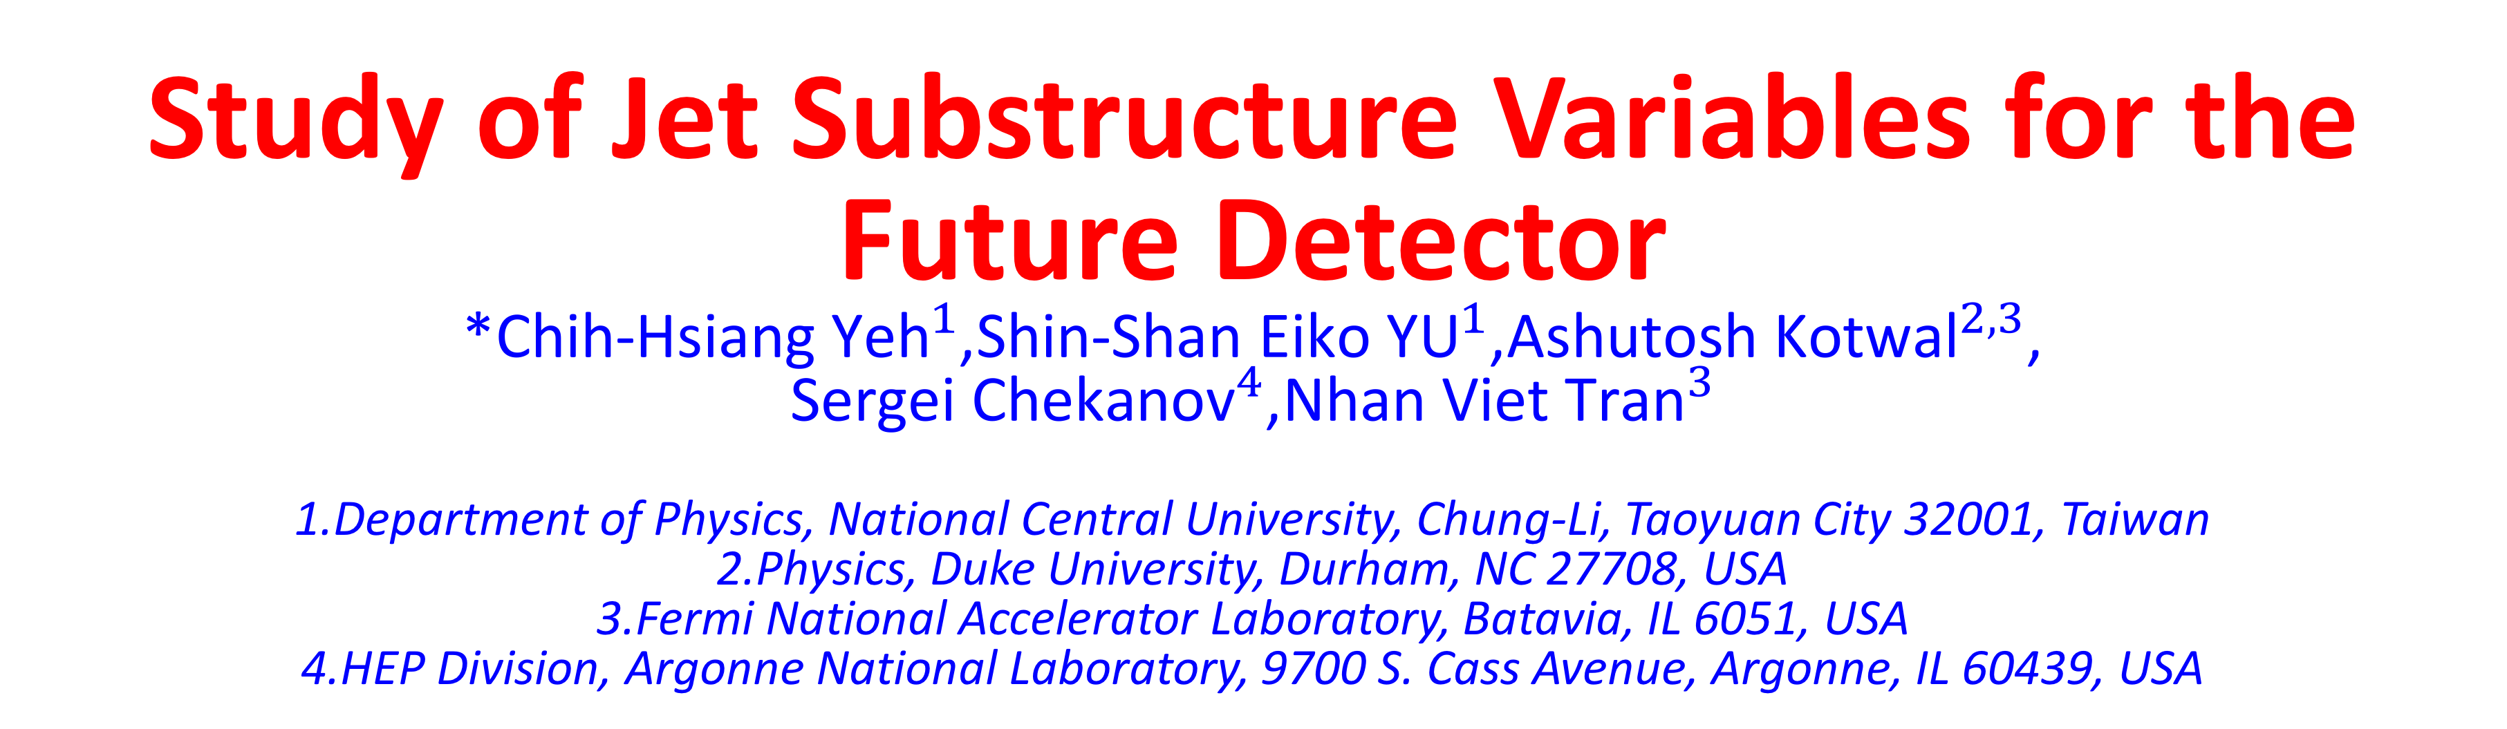
Study of Jet Substructure Variables for the Future Detector
*${\text{Chih}\text{−}\text{Hsiang} \text{Yeh}}^{1}$,${\text{Shin}\text{−}\text{Shan} \text{Eiko} \text{YU}}^{1}$,${\text{Ashutosh} \text{Kotwal}}^{2,3}$, ${\text{Sergei} \text{Chekanov}}^{4}$,${\text{Nhan} \text{Viet} \text{Tran}}^{3}$
1.Department of Physics, National Central University, Chung-Li, Taoyuan City 32001, Taiwan
2.Physics, Duke University, Durham, NC 27708, USA 3.Fermi National Accelerator Laboratory, Batavia, IL 6051, USA 4.HEP Division, Argonne National Laboratory, 9700 S. Cass Avenue, Argonne, IL 60439, USA
Abstract:
In this poster, we study the performance of hadron calorimeter in SiFCC for the future √s=100 TeV pp collider. The GEANT4 full simulation includes calorimeters with different cell sizes. We aim to efficiently separate signal Z’->ww or Z’->tt and background Z’->qq. Various jet substructure variables and Z’ masses from 5 to 40 TeV collision energy are also compared.
Signal and and QCD Background process:
Geant 4 simulation of Future detector,SiFCC
ˋ
QCD Background:
Signal:
Expected limit:
Zprime mass distribution in L=3/fb:
CMS work in progress
CMS work in progress
CMS work in progress
Basic jet recombination algorithm:
$d_{ij}=min(k_{ti}^{2p},$ $k_{tj}^{2p})\frac{∆_{ij}^{2}}{R^{2}}$
$$d_{ib}=k_{ti}^{2p}$$
**If $d_{ij}$<$d_{ib}$,j particle will be merged in I particle**
1.p=0 : Cambridge/Aachen algorithm
2.p=1 : kt algorithm
3.p=-1 : anti-kt algorithm
Leading pt >115 GeV
Leading pt >215 GeV
Leading pt >315 GeV
$$∆_{ij}^{2}=({y_{i}−y_{j})}^{2}+{(∅_{i}−∅_{j})}^{2}$$
Optimization of leading electron pt :
$i,j$: the $i$ and $j$ particle
$k_{ti},$ $k_{tj}$: the particle $i$ and $j$ transverse momentum
CMS work in progress
CMS work in progress
Jet Substructure variables:
Optimization of |Δη(Z,H)|:
CMS work in progress
CMS work in progress
1.N-subjetness:
$τ_{N}=\frac{1}{d_{0}}\sum_{k}{P_{t,k} min\{∆R_{1,k},∆R_{2,k}…∆R_{N,k}\}}$
${ d}_{0}=\sum_{k}{P_{t,k}R_{0}}$
$∆R_{i,k}:angle that k particle from the i axis$
$R_{0}:The cone size we want to cluster$
$τ_{21}=\frac{τ_{2}}{τ_{1}},$ $τ_{32}=\frac{τ_{3}}{τ_{2}}$
2.Energy correlation function
$$ECF\left(N,β\right)=\sum_{i_{1}<i_{2}<..<i_{N}∈J}{(\prod_{a=1}^{N}{PT_{ia}){(\prod_{b=1}^{N−1}{\sum_{c=b+1}^{N}{R_{ibic}}})}^{β}}}$$
$C_{N}^{(β)}≡\frac{r_{N}}{r_{N−1}}$= $\frac{ECF\left(N+1,β\right)ECF(N−1,β)}{{ECF(N,β)}^{2}}$
3.Soft drop:
$$\frac{min(P_{T1,}P_{T2})}{P_{T1}+P_{T2}}<Z_{cut}{(\frac{∆R_{12}}{R_{0}})}^{β}$$
$$β>0:Remove \left(soft\right), maintain\left(soft−collinar\right)$$
$$β=0:Depend on the cut to select the asymmetry$$
$$β<0:Remove both \left(soft\right)and (collinear)$$
Optimization result:
$$P_{T1}$$
 | M=1000 | M=2000 | M=3000
Leading pt | Pt>195 GeV | Pt>415 GeV | Pt>495 GeV
Sub-Leading pt | Pt>75 GeV | Pt>175 GeV | Pt>195 GeV
|d Eta (Z,H)| | |d Eta (Z,H)| <1.5 | |d Eta (Z,H)| <2.0 | |d Eta (Z,H)| <2.5
$$R_{12}$$
$$P_{T2}$$
Summary :
The two optimization methods get consistent results of the best cuts, and the |d Eta| cut will be considered to be added into the final selection.
Reference :
AN-2015-186 (CMS internal analysis note)

